Slide 1

BREAST CANCER DETECTION: USING MACHINE LEARNING
GUIDED BY
SRI NATH DWIVEDI
DEPARTMENT OF COMPUTER SCIENCE AND ENGINEERING
SUBMITTED BY
ASHUTOSH SINGH (19)
SWAPNIL SIDDHARTHA (58)
UMANG RAJ CHAURASIA (63)
Notes:
Are your classroom colors different than what you see in this template? That’s OK! Click on Design -> Variants (the down arrow) -> Pick the color scheme that works for you!
Feel free to change any “You will…” and “I will…” statements to ensure they align with your classroom procedures and rules!

Slide 2

BREAST CANCER: AN OVERVIEW
Breast cancer is major cause of death in women around the world. According to WHO (World Health Organization), breast cancer accounted for maximum deaths (2.26 million cases), worldwide in 2020 out of the 10 million cases of cancer.
Breast cancer starts when cells in the breast begin to grow out of control. These accumulations of cells are called tumors and they can often be seen on an x-ray or felt as a lump.
There are two types of tumors. One is benign which is non-cancerous and the other one is malignant which is cancerous.
If it does not identify in the early-stage then the result will be the death of the patient.
The doctors do not identify each and every breast cancer patient. That’s the reason Machine Learning Engineer / Data Scientist comes into the picture because they have knowledge of maths and computational power.

Slide 3

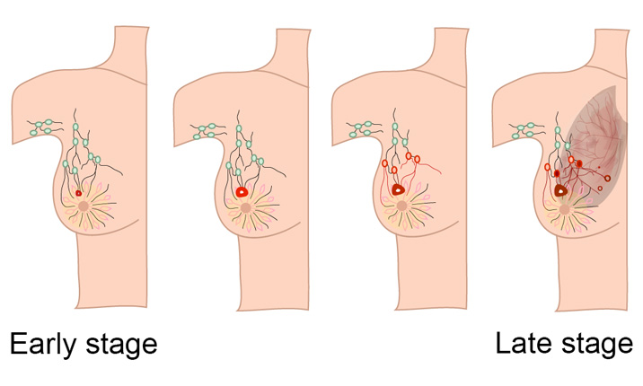
PROBLEM STATEMENT
Predicting if the cancer diagnosis is benign or malignant based on several observations/features i.e its radius, area, smoothness, texture etc.
Using Machine learning technologies to predict the tumors.

Slide 4

TECHNOLOGY USED
MACHINE LEARNING USING PYTHON
Python libraries such as numpy, pandas.
Sklearn library with many subordinate models such as model_slection.
Platform used for implementation: Google colaboratory.
Language used: python

Slide 5
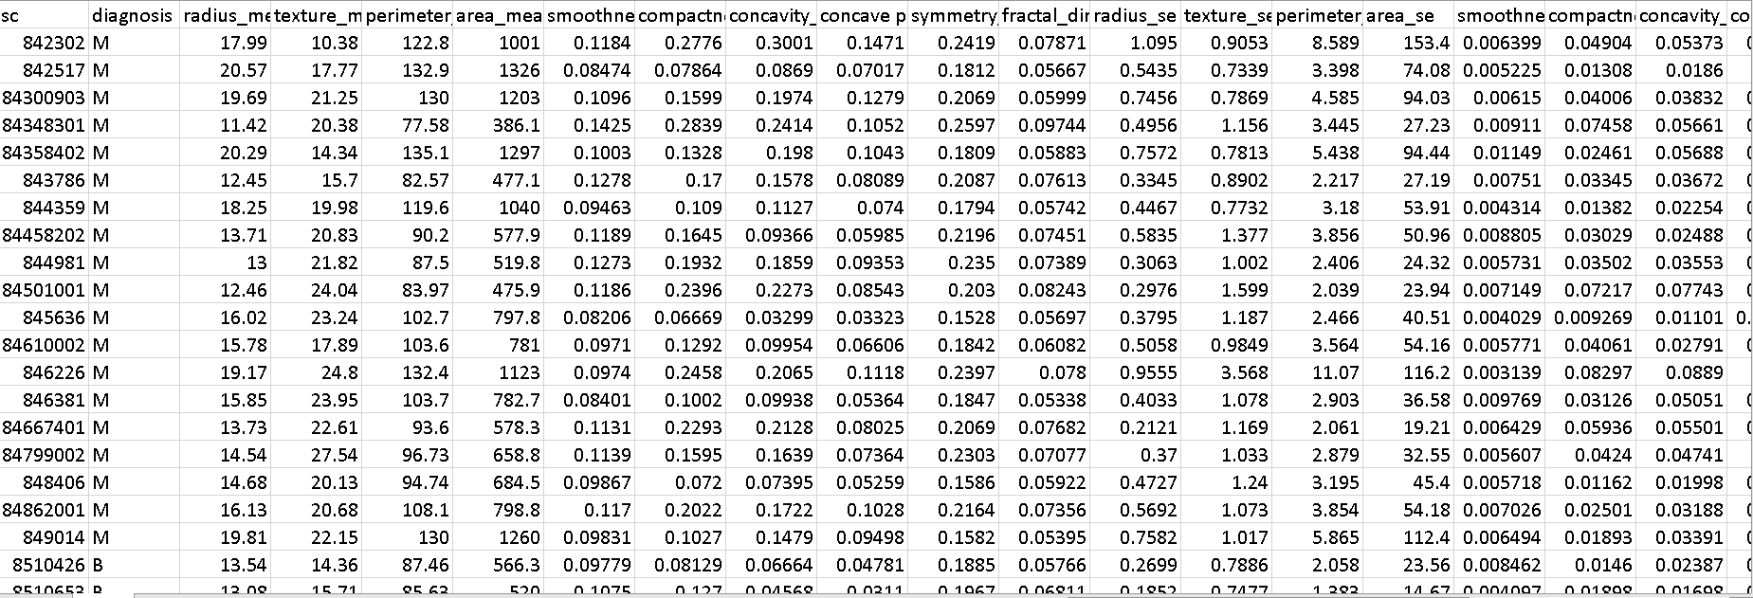
DATASET USED
Source: Kaggle

Slide 6
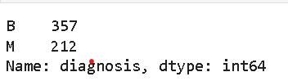
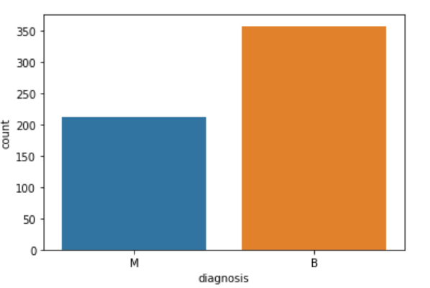
EXPLORING AND PREPARING THE DATA
Importing the data Importing the dataset in the google colaboratory
et in the google colaboratory
This graph indicate that 357 masses are benign and 212 malignant

Slide 7
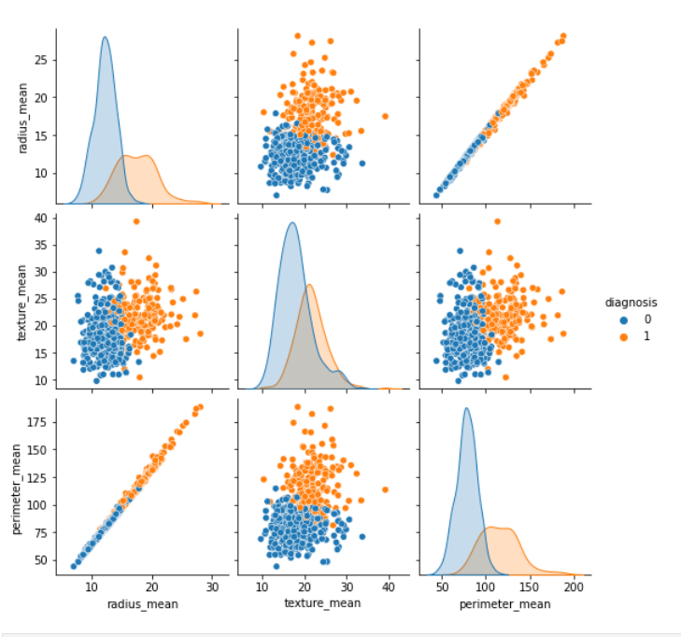
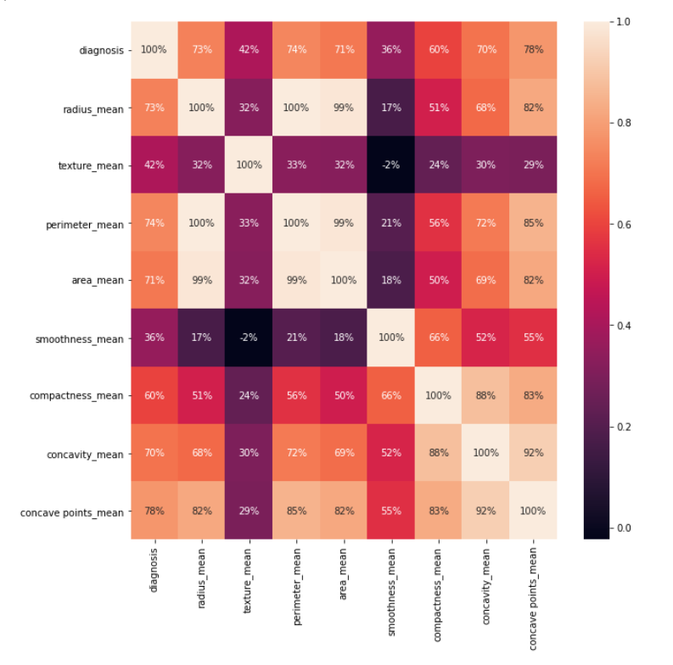
VISUALIZATION
A vector x of numeric values, and for each value of x, subtracts the minimum value in x and divides by the range of values in x.

Slide 8
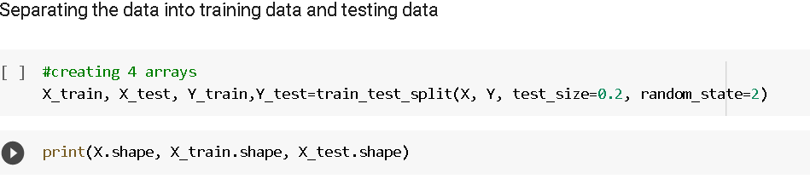
DATA PREPARATION
Separating the dataset into training and testing dataset
80% of the dataset is used to train the model and remaining to test the model.

Slide 9
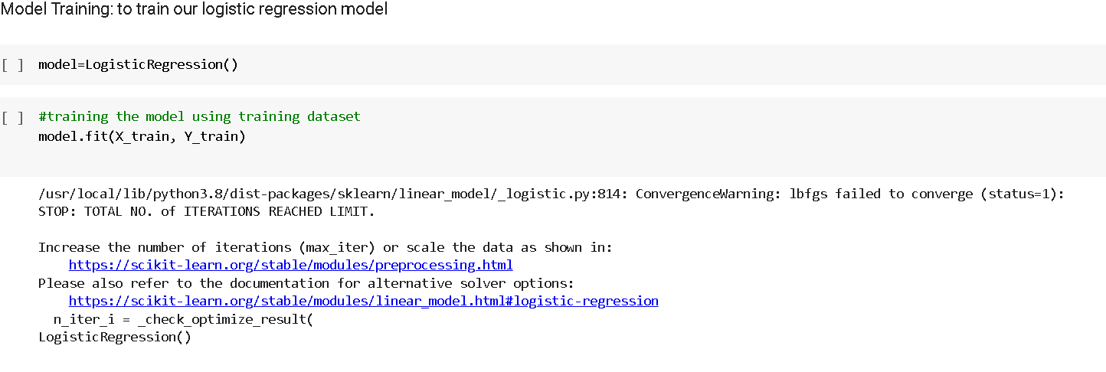
TRAINING THE MODEL
Training the model on the data

Slide 10
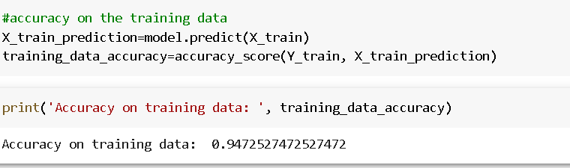
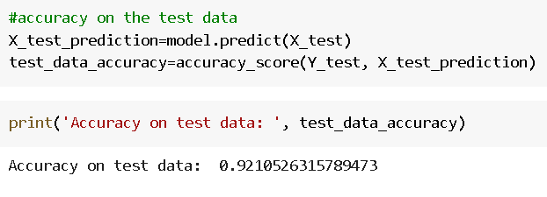
ACCURACY SCORE
To check the accuracy of the training data
To check the accuracy of the test data

Slide 11
CONCLUSION
Combining multiple risk factors in modelling for breast cancer prediction could help the early diagnosis of the disease with necessary care plans. Collection ,storage and management of different data and intelligent systems based on multiple factors for predicting breast cancer are effective in disease management.

Slide 12
THANK YOU

